Slide 1
Box Office: Predicting Movie Revenue with Data Science
Yuwenqian Chen, Yuxuan Weng, Senhui Zhao

Slide 2
Group Member
Yuxuan Weng
demonstrated exceptional coding skills throughout the project, taking the lead in implementing various machine learning models. His proficient coding abilities allowed them to efficiently translate complex algorithms into functional and optimized code.
Yuwenqian Chen
demonstrated strong analytical skills and attention to detail by crafting a well-structured and insightful conclusion for the project. Yuwenqian also took the lead in creating the presentation slides, effectively summarizing the key findings.
Senhui Zhao
made a valuable contribution to the team by meticulously cleaning and organizing the data, ensuring its integrity and quality. Senhui also played a pivotal role in preparing the presentation slides, distilling complex information into concise and visually appealing slides that effectively communicated key project aspects to audience.

Slide 3
Background
This project aims to predict movie revenue by exploring various factors, including cast, crew, plot keywords, budget, posters, release dates, languages, production companies, and countries. The project involves conducting exploratory data analysis to identify useful features, counting the number of movies released by day of the week, month, and year, identifying movie genre trend shifting patterns, and integrating external datasets. Three models will be built, trained on the training set, and evaluated on the test set using accuracy metrics such as Residual Standard Error. The dataset will be split further to include a cross-validation set to improve the model's performance.

Slide 4
Data Munging
Load Data
Data Exploration
Clean Data
Merge datasets
Handle missing value
Handle duplicate value
Handle outlier
Parse Json
Extract information from merged data frame

Slide 5
Load Data
Load two csv datasets:
tmdb_5000_credits.csv
tmdb_5000_movies.csv

Slide 6
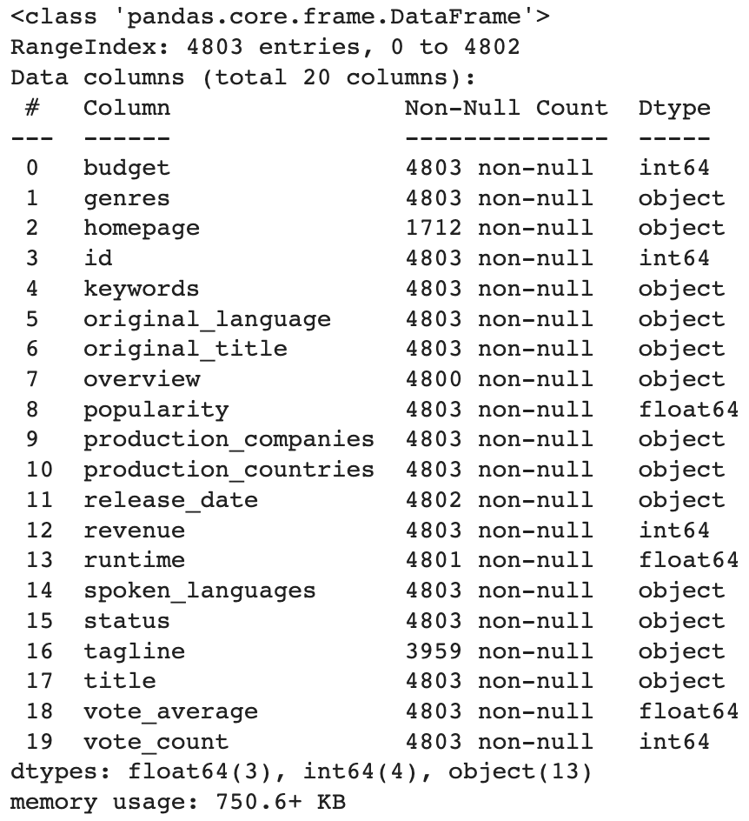
Explore Movies dataset
movie_df.info()
According to the output, we found out that there are
20 variables and 4803 observations

Slide 7
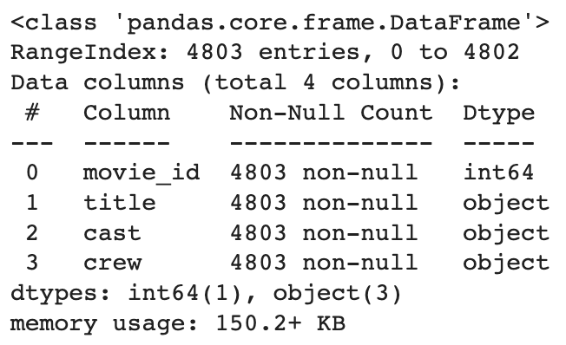
Explore Credits dataset
credit_df.info()
According to the output, we found out that there are
4 variables and 4803 observations

Slide 8
Clean Data

Slide 9
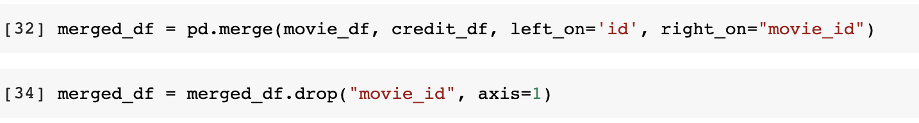
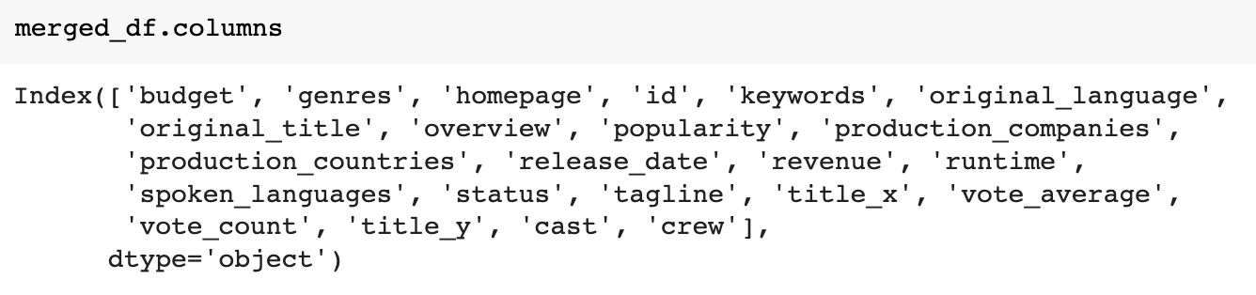
Merge Datasets
We merge two dataframes, movie_df and credit_df, using a common column 'id' in movie_df and 'movie_id' in credit_df.
And we remove the column containing the redundant information from the original credit_df dataframe.

Slide 10
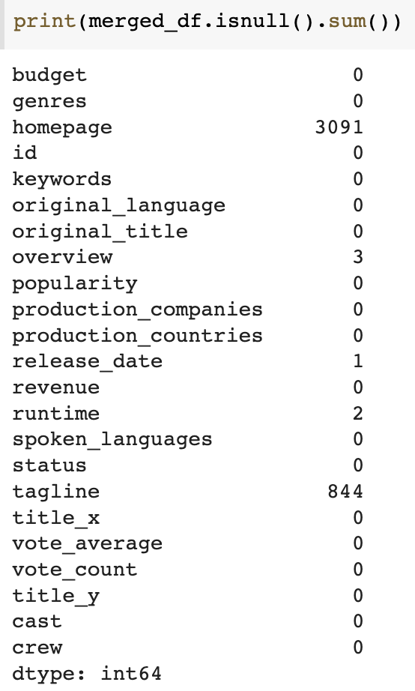
Handle Missing Value
This table gives the total number of missing values in each column.
The variables 'homepage', 'overview', 'release_date', 'runtime', and 'tagline' have varying numbers of missing values in the dataset.

Slide 11
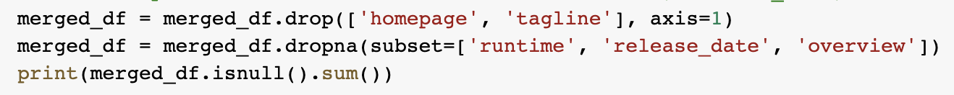
Handle Missing Value
We removed the 'homepage' and 'tagline' columns from the dataset as they are not useful for our data analysis.
As the variables 'runtime', 'release_date', and 'overview' have only a few missing values, we can remove the corresponding rows from the dataset.

Slide 12
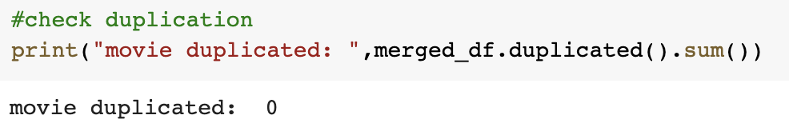
Handle Duplicate Value
From this output, we can found out that there is no duplicate value in merged dataset.

Slide 13
Handle Outlier
Use sns to generates a box-and-whisker plot of the distribution of values in the target column. Check if there are outliers in target values.
Setting the highest and lowest values to a predetermined percentile within the range of the data.
We will handle outlier in variable ‘revenue’, ‘budget’, ‘vote_count’.

Slide 14
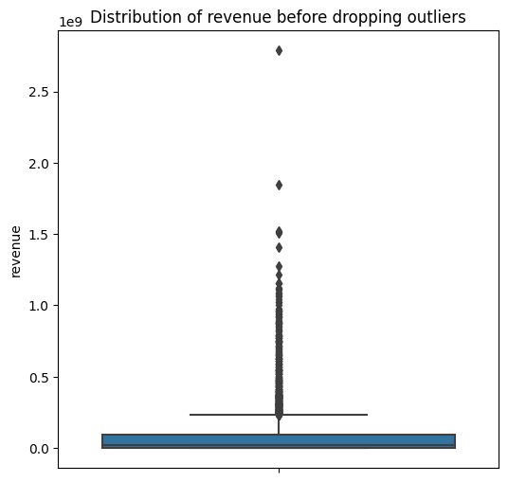
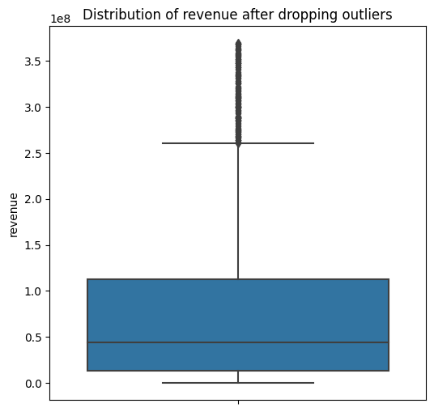
Drop Outliers in Revenue

Slide 15
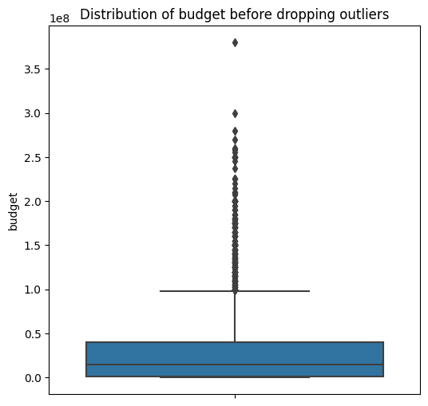
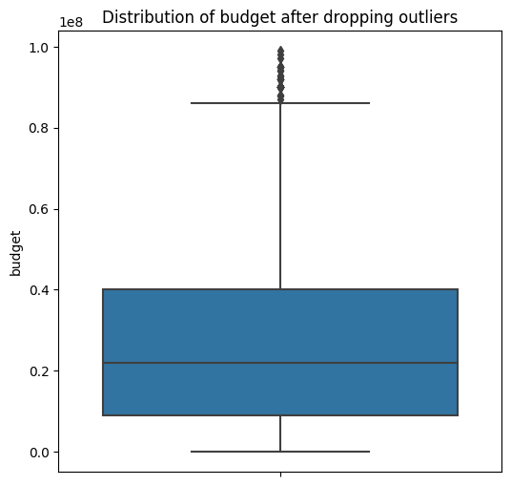
Drop Outliers in Budget

Slide 16
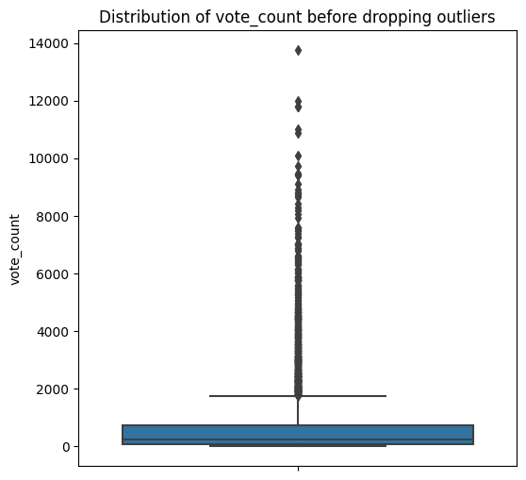
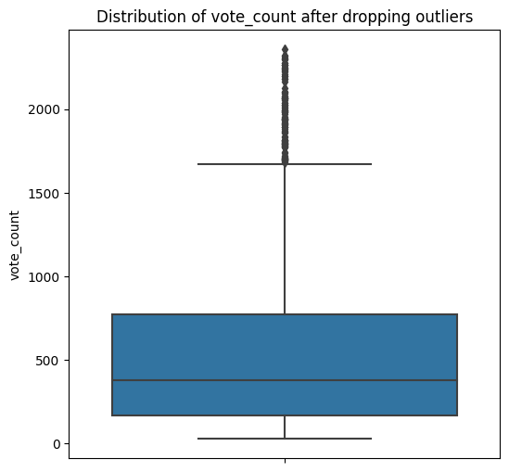
Drop Outliers in Vote_count

Slide 17
Parse Json

Slide 18
Parse Json
Use library ast to extract information from Json format.
There are 6 variables which are list type. We defined a extract_name function to extract useful information from these columns.
There are 2 variables which are dictionary type. We defined two functions to extract ‘get_producer’ and ‘get_director’ from the ‘crew’ column.
Those information will help us to analyze the prediction of the revenue of movie.

Slide 19
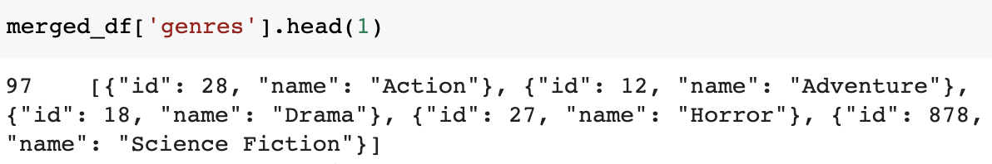
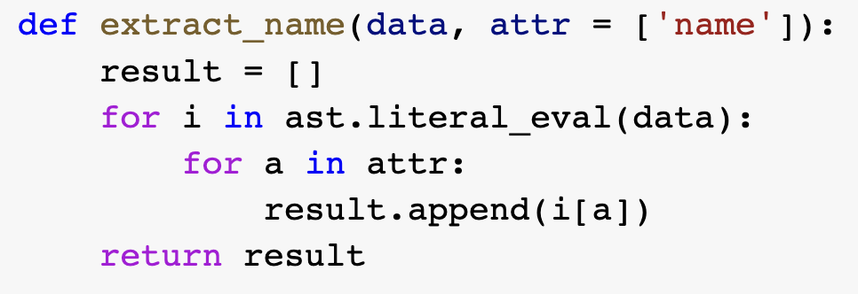
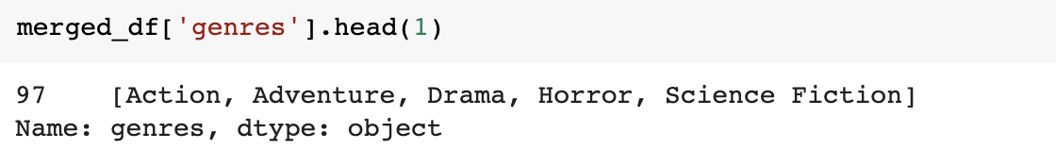
Extract Name
The purpose of this function is to extract name from a list of dictionaries represented as a string.
It will help us on splitting the genres in exploring the shifting trend of genres.
We will also apply this function to other 6 variables.

Slide 20

Extracted Merged Data Frame

Slide 21
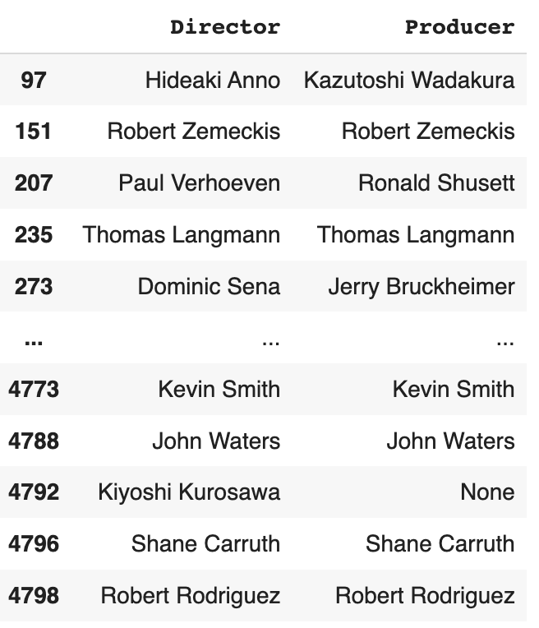
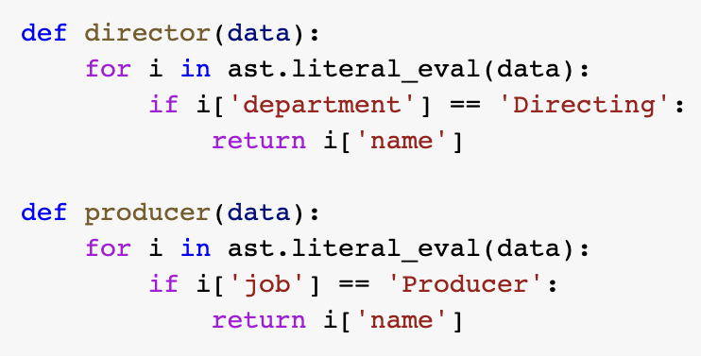
Parse ‘crew’
We extract director and producer from ‘crew’ column.

Slide 22
Data visualization

Slide 23
Release Date Analysis
Analysis of Movie Release Patterns by Day, Month, and Year

Slide 24
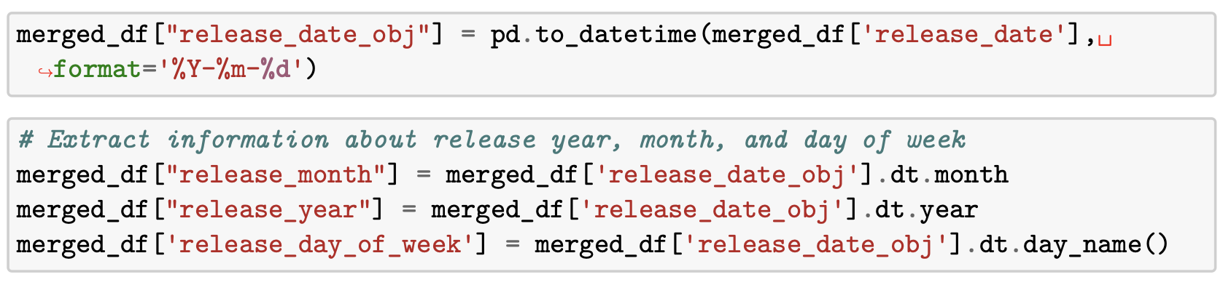
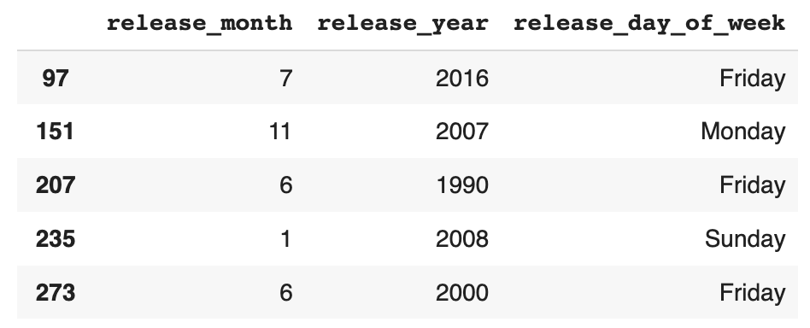
Release Date Analysis
First of all, we convert the ‘release_date’ column into a datetime object, format as %Y-%m-%d.
Then, extract the information about release year, month, and day of week from ‘release_date_obj’
Finally, display and double-check the date after we processed.

Slide 25
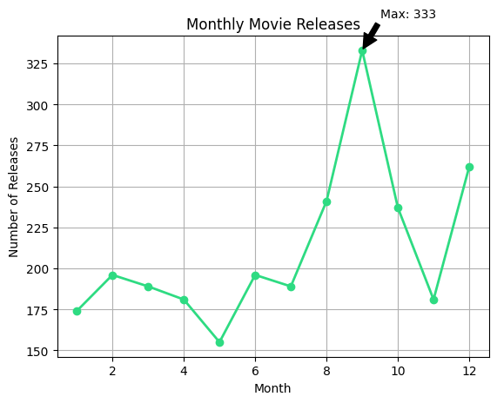
Monthly Movie Releases
To better understand how the data evolves over time and identify peak points, we organized the release data into lists for each month and plotted it using line charts. After analyzing the data in this way, we discovered that the month of September had the highest number of movie releases, with a total of 333 movies. This approach allowed us to easily identify the highest data points for each month and visualize the changes in the data over time.

Slide 26
Yearly Movie Releases
In the yearly movie releases, we first create an empty dictionary called "year_dic" to store the count of movies released each year. Then we loop through each year in the "release_year" column of the merged_df dataframe, incrementing the count of the corresponding year in the "year_dic" dictionary.
Next, we sort the dictionary items in ascending order based on the keys (years) using the "sorted" function. Then we create a bar chart and passing the years as the x-axis values and the movie count for each year as the y-axis values.
To make the plot more readable, we also add a grid using the "plt.grid" function. Finally, we display the plot using the "plt.show" function.

Slide 27
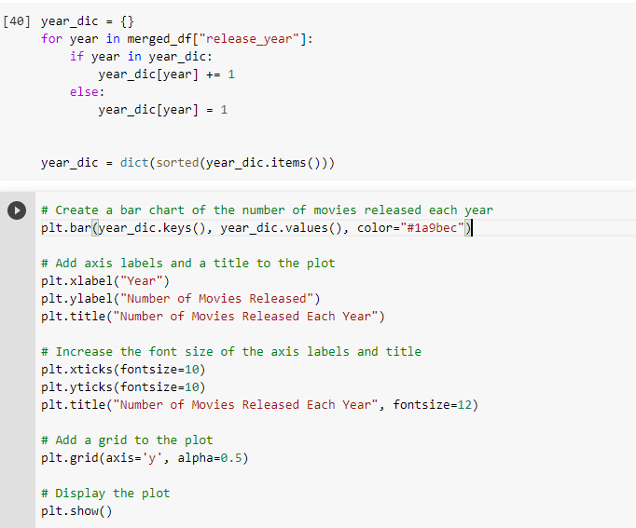

Slide 28
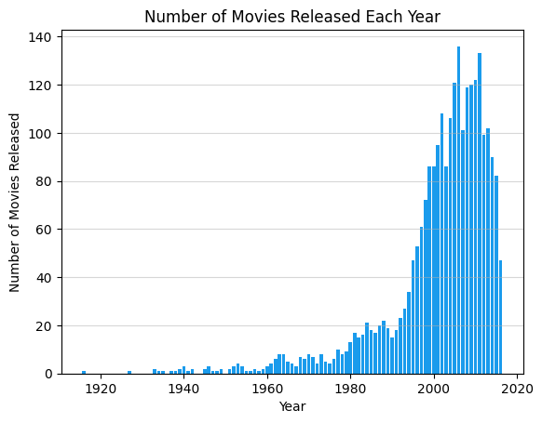
Yearly Movie Releases
The bar chart shows that the number of movies released each year has increased steadily from the early 2000s, with a peak of 136 movies released in 2006. After this peak, there appears to be a plateau in the number of movies released, followed by a slight decrease in more recent years.

Slide 29
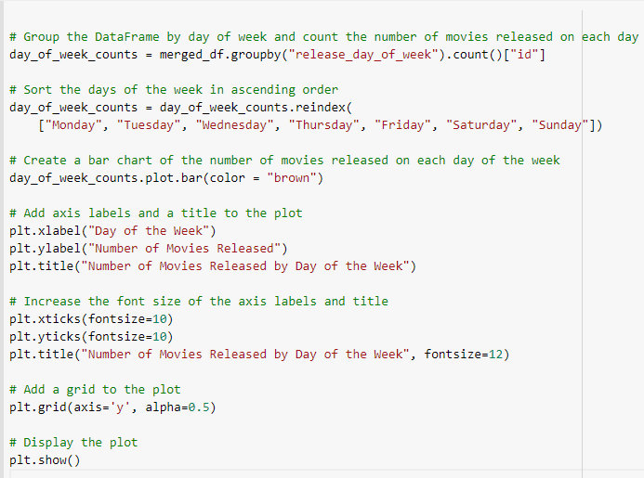
Day of The Week Movie Releases
We first group the merged_df dataframe by the "release_day_of_week" column using the "groupby" method, and then count the number of movies released on each day of the week using the "count" method.
Then we sort the days of the week in ascending order using the "reindex" method, and create a bar chart of the number of movies released on each day of the week using the "plot.bar" method.

Slide 30
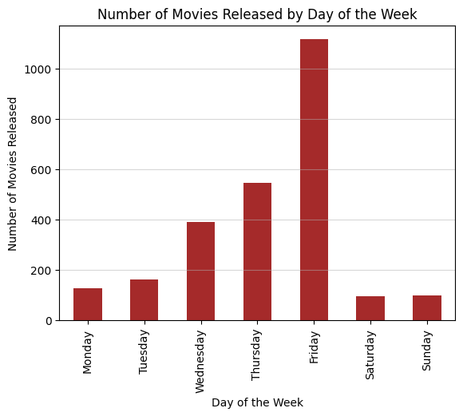
Day of The Week Movie Releases
The resulting plot shows that the number of movies released varies by day of the week, with a peak on Fridays and a gradual decrease in the number of releases on weekends. The lowest number of releases occurs on Mondays.
This trend could be due to a variety of factors, including consumer behavior and preferences, competition for screen time and box office revenue, and the way movies are marketed and distributed.

Slide 31
Movie Genre Analysis
Identifying Genre Trend Shifting Patterns

Slide 32
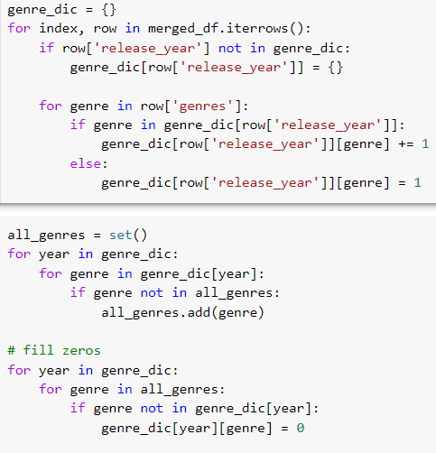
Movie Genre Analysis
We creates a 2D dictionary where the outer dictionary has the year as its key and the inner dictionary has the genre as its key, storing the frequency of each genre that occurs in the dataset for that year.

Slide 33
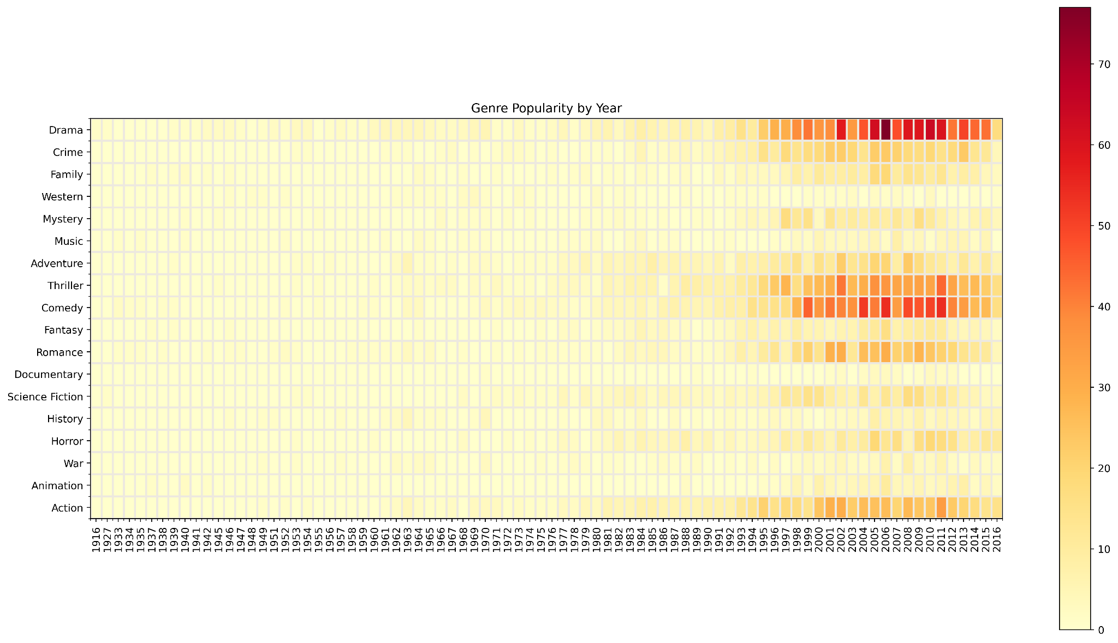

Slide 34
Movie Genre Analysis
This heatmap that shows the popularity of each movie genre over time. The x-axis represents the years, and the y-axis represents the movie genres. The intensity of each color represents the popularity of each genre in a particular year, with brighter colors indicating more popular genres.
From the heatmap, we can see that the popularity of some genres has remained consistent over time, such as drama, comedy, and thriller. Other genres, such as fantasy and science fiction, have become more popular over the years. We can also see some fluctuations in popularity for certain genres, such as horror and romance.

Slide 35
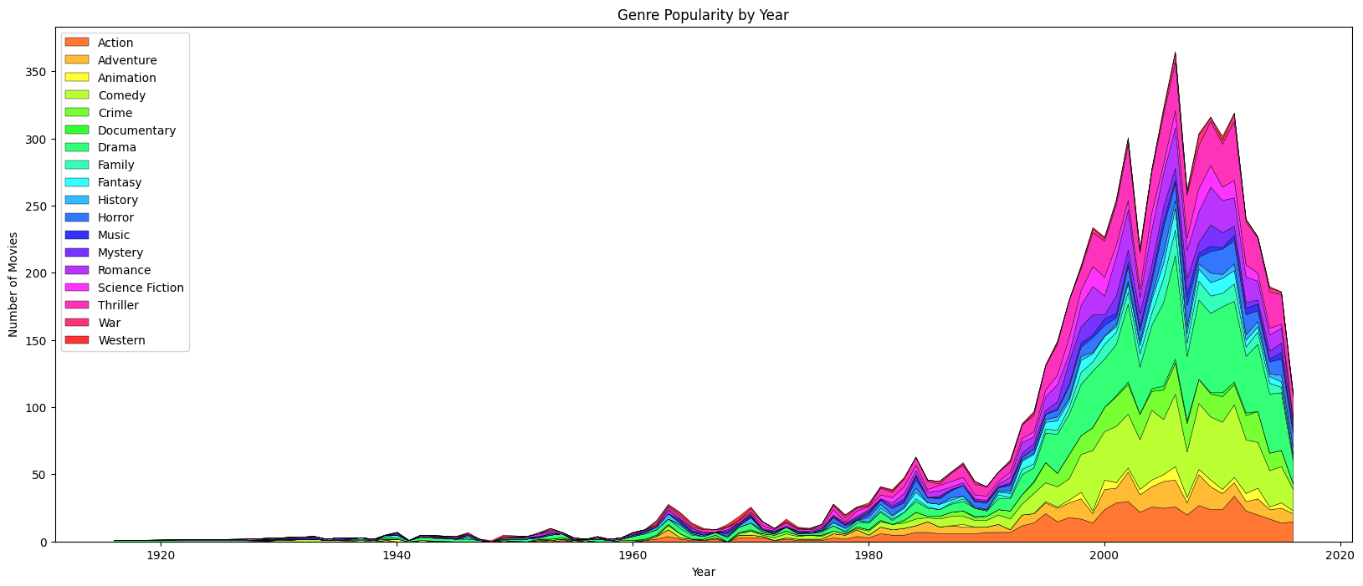

Slide 36
Movie Genre Analysis
The stacked area plot shows the popularity of movie genres over time. Each color represents a different genre and the height of the colored area at any given year represents the number of movies released in that genre in that year. The x-axis represents the years and the y-axis represents the number of movies. The legend shows which color corresponds to which genre. From the plot, we can observe the rise and fall in popularity of various genres over time, and also see which genres have consistently remained popular throughout the years.

Slide 37
Modelling

Slide 38
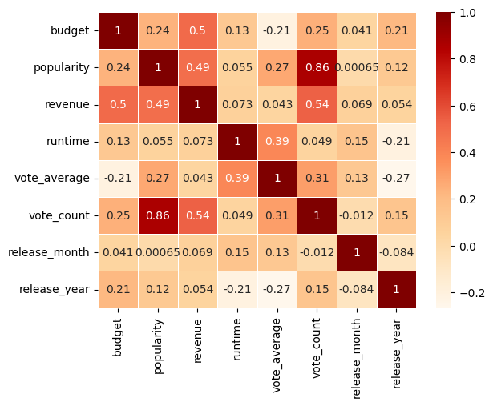
The heatmap analysis shows that budget, popularity, and vote_count have strong positive correlation with revenue, while vote_average has weak correlation. Therefore, we will focus on these three features to build a predictive model for the dataset. Higher budgets, more popular, and more vote_count tend to generate higher revenues, but the average rating of a movie is not a strong predictor of its revenue.

Slide 39
Linear Regression

Slide 40
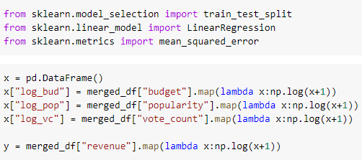
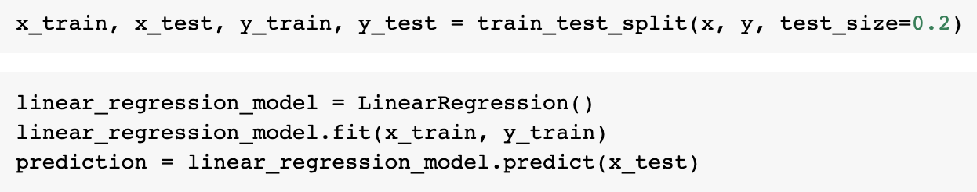
Linear Regression
We creates a new pandas DataFrame named x that includes three new columns: "log_bud", "log_pop", and "log_vc". These columns are created by applying the NumPy log function to three columns from the merged_df DataFrame: "budget", "popularity", and "vote_count", respectively.

Slide 41
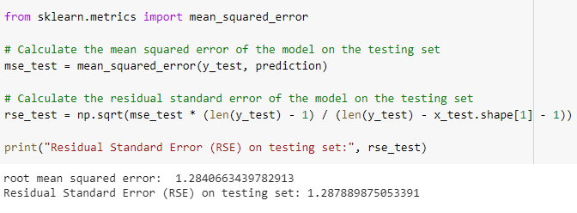
Linear Regression
RSE: 1.288
RMSE: 1.284
Calculate the root mean squared error and residual standard error, the linear regression model appears to have decent predictive power on the testing set.
The result indicates that the model has relatively low errors and can be used to predict the revenue of movies in the dataset with a reasonable degree of accuracy.

Slide 42
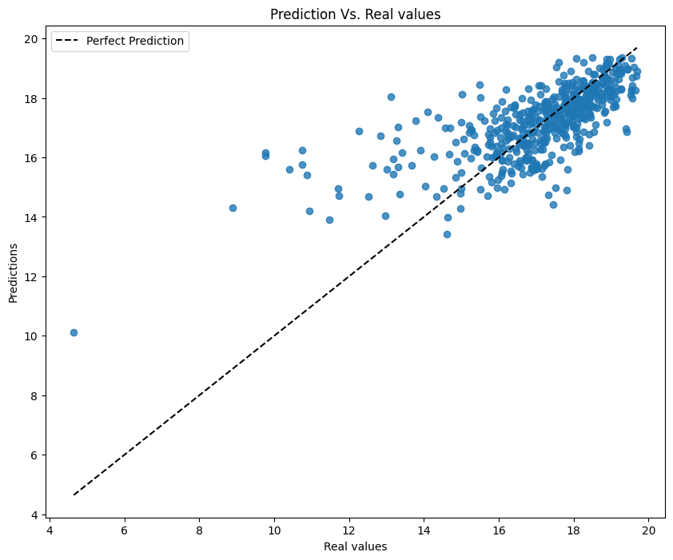
Linear Regression
The scatter plot of real values versus predictions shows that the model is able to predict revenue reasonably well, with most of the points falling near the line of perfect prediction.

Slide 43
Logistic Regression

Slide 44
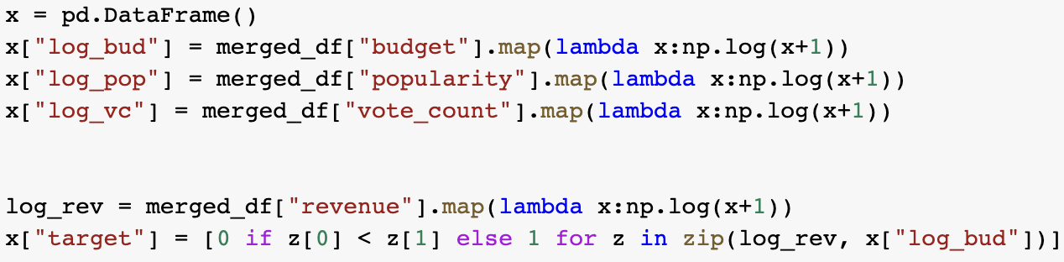
Logistic Regression
We create a new column called ‘target’ which is based on a binary classification of movies into two categories based on their revenue and budget: if the revenue is less than the budget, the movie is classified as a "loss" (0), and if the revenue is greater than or equal to the budget, the movie is classified as a "success" (1)

Slide 45
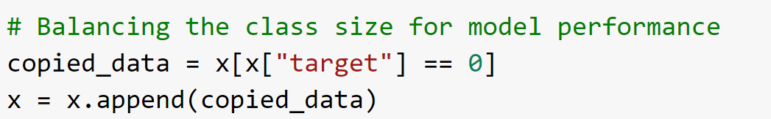
Balance the class size
Balancing the class size is necessary in machine learning to address class imbalance. Class imbalance occurs when the number of instances in different classes is significantly different, which can lead to biased models and poor performance on the minority class. By balancing the class size, we ensure that the model is exposed to sufficient samples from all classes, allowing it to learn patterns and make accurate predictions for both majority and minority classes.
Notes:
Improved Model Performance: By increasing the number of instances in the small class, we provide the model with more training data for that class. This can help the model better capture the patterns and characteristics of the minority class, leading to improved performance and accuracy.
Reduced Class Imbalance Bias: Class imbalance bias can adversely affect model performance, especially when the minority class has limited representation. By increasing the size of the small class, we reduce the imbalance ratio, allowing the model to allocate more resources and attention to learning from the minority class.
Enhanced Generalization: A larger representation of the small class helps the model generalize better to unseen data. It allows the model to learn a more robust decision boundary and make accurate predictions for instances that belong to the minority class.
Mitigated Overfitting: Class imbalance can contribute to overfitting, where the model becomes overly specialized in predicting the majority class due to its dominance in the training data. Balancing the class sizes can mitigate this issue and promote better generalization.
Increased Stability: Having a balanced dataset with classes of similar sizes can improve the stability and consistency of model training. It reduces the risk of the model being biased towards the majority class and produces more reliable and consistent predictions.

Slide 46
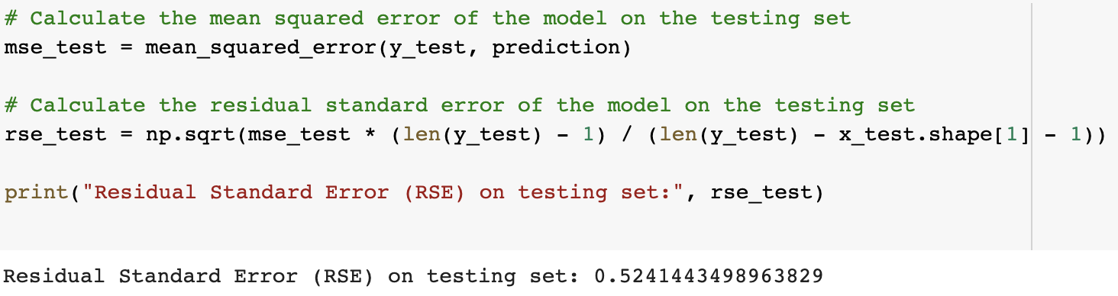
F1: 0.778
RSE: 0.524
The logistic regression model achieved an F1 score of 0.778, indicating that it can accurately predict whether a movie will earn above or below its budget based on the selected features. The RSE value of 0.524 suggests that there is some level of error in the model's predictions. Overall, the model's performance is decent, but there is still room for improvement.

Slide 47
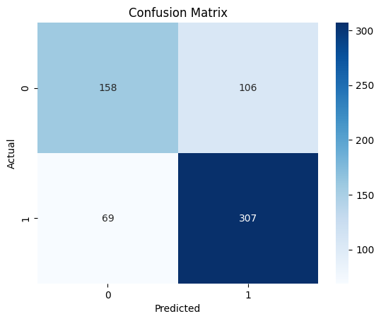
Logistic Regression
This confusion matrix give an idea of how well the logistic regression model is performing. By looking at the matrix, we can see how many true positives, true negatives, false positives, and false negatives the model produced.

Slide 48
KNN Classifier

Slide 49
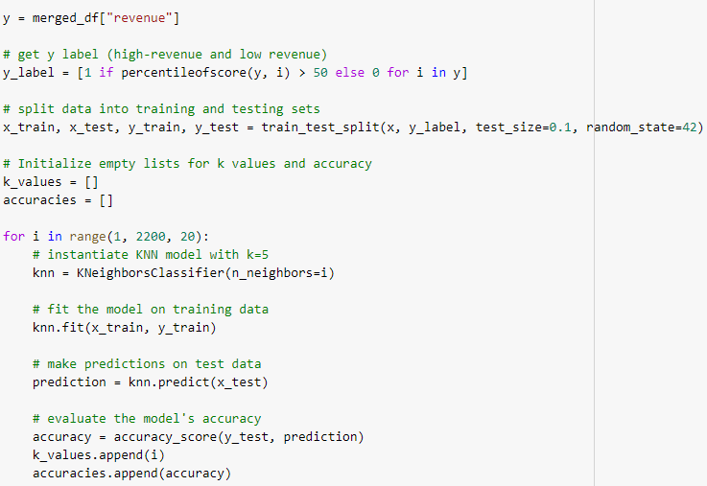
KNN Classifier
First of all, the revenue column labels the data as high-revenue or low-revenue based on its percentile rank.
Next, trains a KNN model with different values of k and evaluates its accuracy using the accuracy_score function. The results are plotted on a graph to determine the optimal value of k for the model.

Slide 50
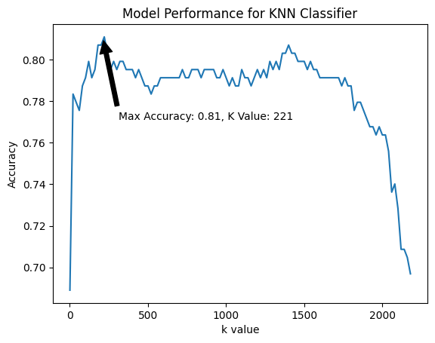
KNN Classifier
Performing K-Nearest Neighbors (KNN) classification on a dataset containing information about movie budgets, popularity, and vote count to predict whether a movie will have high or low revenue.

Slide 51
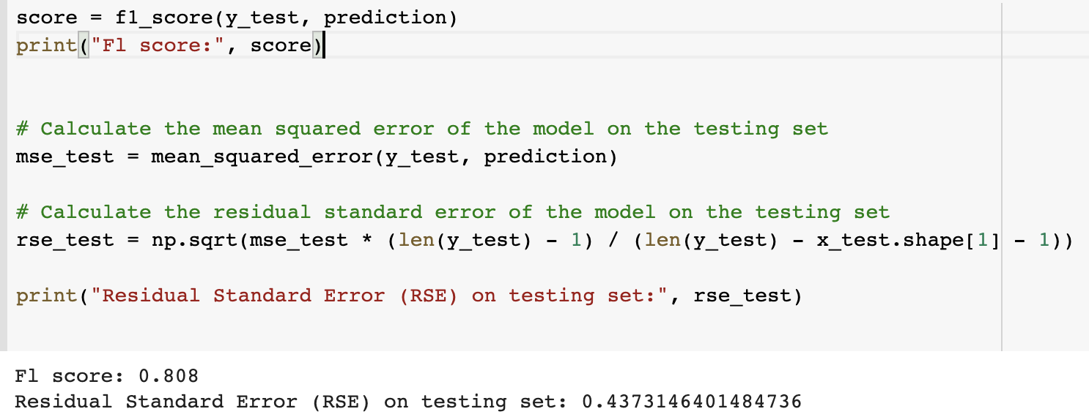
KNN Classifier
F1: 0.808
RSE:0.437
The linear regression model has an F1 score of 0.808 and RSE of 0.437, indicating that the model has a relatively good fit to the data.

Slide 52
Conclusion

Slide 53
Comparing Performance - RSE
0.524
1.288
0.437
Logistic Regression
Linear Regression
KNN
Classifier

Slide 54
Comparing Performance - Cross Validation Score
0.723
0.835
0.780
Logistic Regression
Linear Regression
KNN
Classifier

Slide 55
Models
Linear Regression Model - The model is a regression model that utilizes budget, popularity, and vote count as input features to predict movie revenue. It learns the patterns and correlations between these features and revenue from a training dataset, and can then generate revenue predictions for new movies based on these learned relationships.
Logistic Regression Model - The logistic regression model takes budget, popularity, and vote count as input features to classify movies as either profitable or not. It learns the relationship between these features and the binary outcome of profitability from a training dataset, using a logistic function to model the probability of a movie being profitable.
KNN Model - The model takes into consideration the budget, popularity, and vote count of movies to classify them as high-revenue or low-revenue. It does this by comparing the features of a new movie to the K number of nearest neighbors in the training dataset. The label assigned to the new movie is determined by the majority class of its K nearest neighbors.

Slide 56

Thank You

